Slide 1
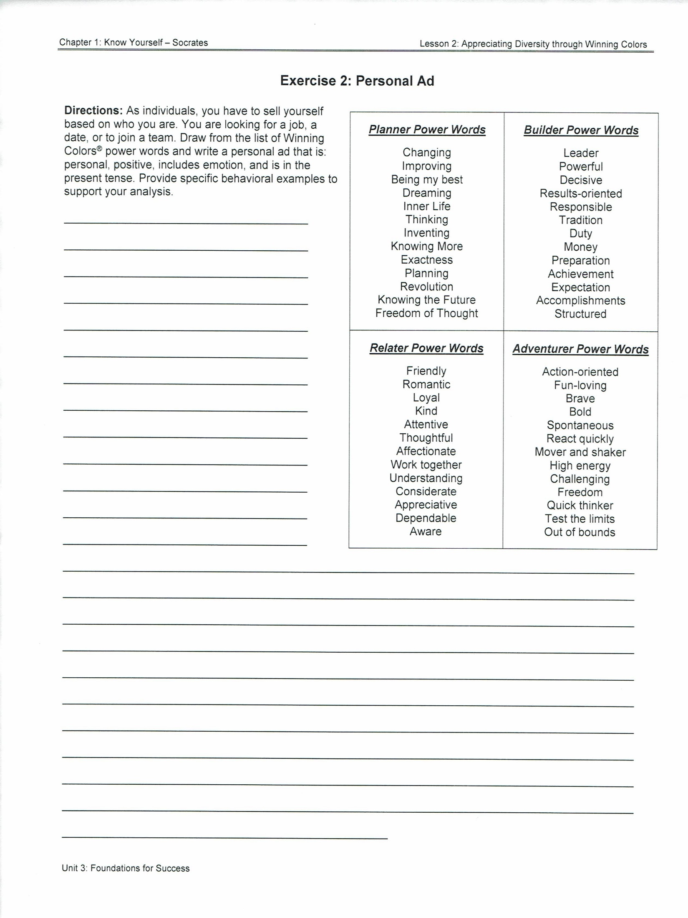
(Highlight this and begin typing.)
(Highlight this and continue typing.)

